Slide 1


Theory +Economic Survey Vol.2 + Vol.1 + Budget 2016
1.Banking Finance
6.HRD
2.Budget-Fiscal Policy
3.BoP
4.Sectors of Economy
5.Infra
V2C2-Pub.Fin; V1C3-JAM
V2C3-Monetary mgmt+FI
V2C4-External sector
V2C5-Price,Agri.; V2C6,7
V2C8-Paris Summit, Energy
V2C9-Social infra.
V1C4-Agri ; V1C9-Fertilizer
V1C5-mother-child
V1C6-bounties; V1C7-Fiscal Cap
V1C8-PTA
V1C2-Chakravy; V1C10-Labour
V1C11-Powering 1 India
B1. Financial Sector Reforms
B2. Fiscal Discipline
B3. Tax Reforms; B4. Ease of
B5. Agro: 2x farmer income
B6. Rural infra-employment
B7. Infrastructure
B8. Social Sector & healthcare
B9. Education, Skills, Jobs
V2C1- Chakravyuh challenge
V1C1- Twin Balancesheet
IYB:7-Commerce

Slide 2
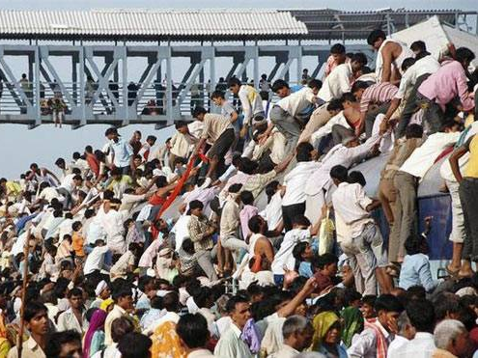
BES166 ► HRD: Today’s Topics
Census
Edu. Policy 2016
Health-Women, Children
HDI-2015 | SDG

Slide 3
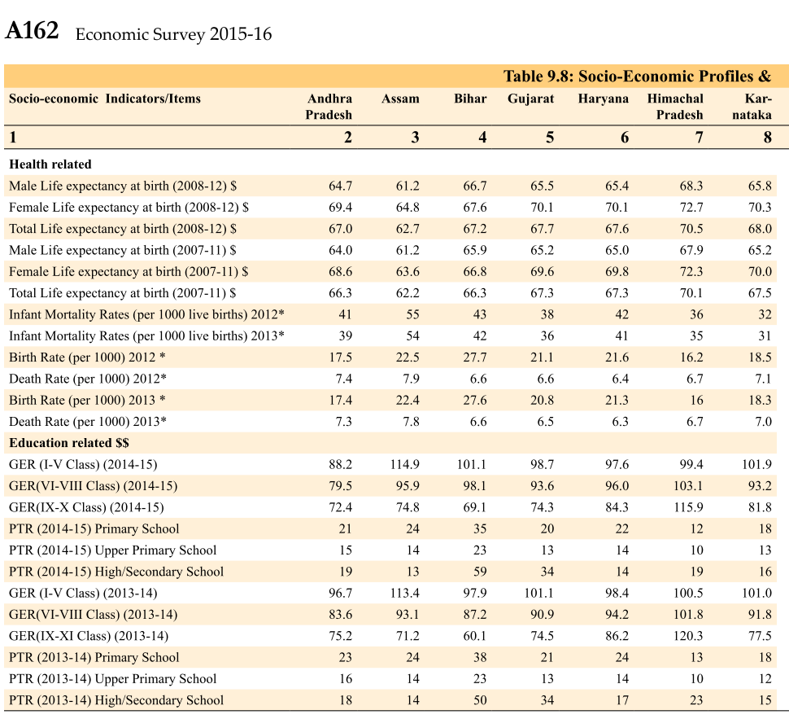
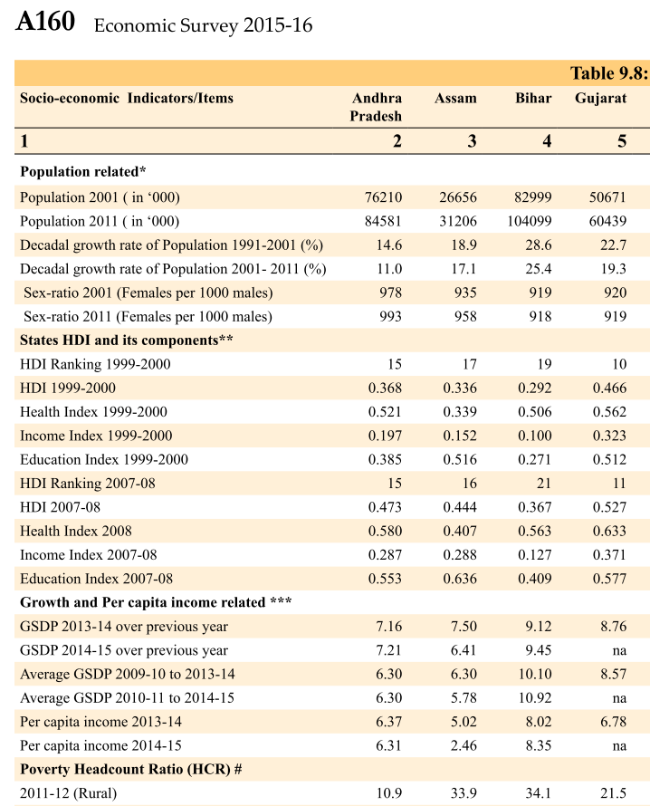
Self study for interview & StatePSC

Slide 4
Weaker sections, language
Self study
Laxmikanth
IYB
Ch. 3, 20, 28
Ch. 7, 33, 37, 42, 43, 44, 50-51, 58, 63
ONLY IF TIME permits
NCERT Sociology, Pol.Sci

Slide 5
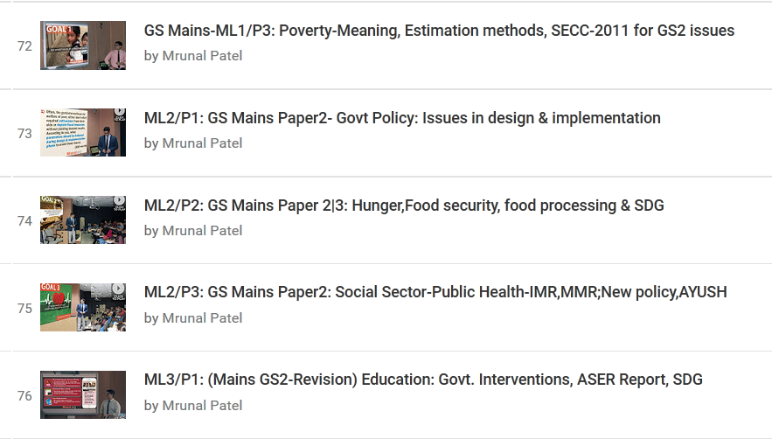
For prelims: Just glance over

Slide 6
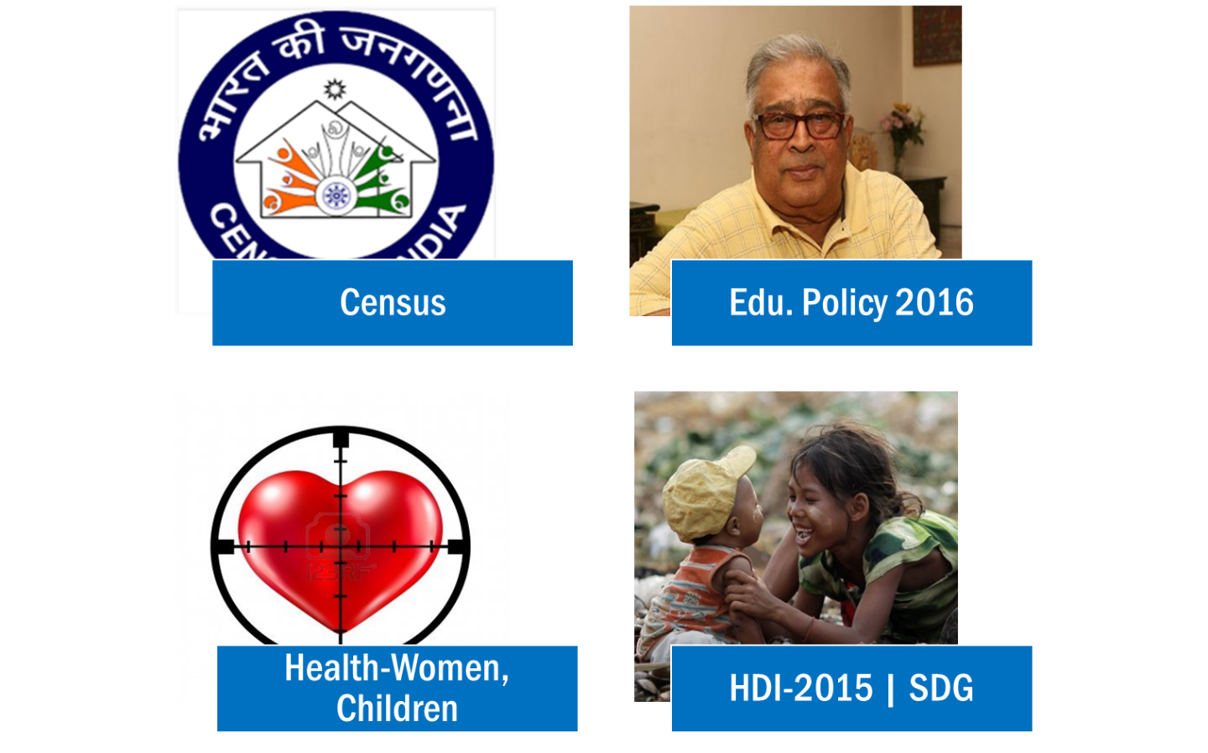
BES166 ► HRD: Today’s Topics
Census Theory
Pop. Growth-stages, concepts, formulas
Diversity: Language, Religion, Ethnic Composition
NCERT Sociology terms

Slide 7
Where is this mentioned?
Census / population counting was mentioned in ___?
Greek: Demography
Rome: Cadastral survey
Kautilya’s Arthshashtra
Abu Fazl’s Aiene-Akbari
All of above

Slide 8
Census in Modern world
1801
England
1790
USA first modern
Indian Census = largest because China doesn’t do it.
1872: Lord Mayo
1881: Lord Rippon- every decade
2011: 7th Census of Free India, 15th overall
1st Census commissioner: W.W.Plowden
Ilbert Bill : Indian magistrate can try British criminal

Slide 9
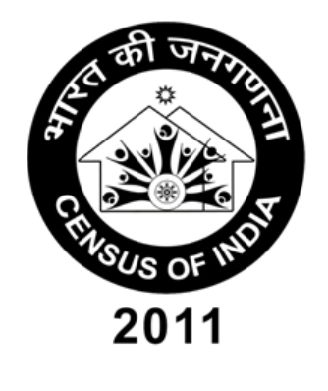
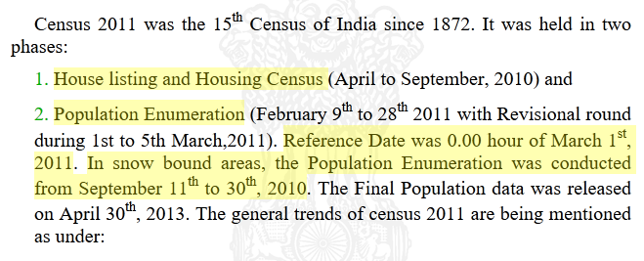
CENSUS?
Jurisdiction
Union List Entry 69: Census
Office of the Registrar General and Census Commissioner (MHA)
Directors @State/UT
Collector / Muni.Commissioner
Bottom: Enumerator

Slide 10
Report vs. author
1901 Census-Herbert Risley- caste info gather. (NCERT-12)
Match the following
Census: Home Ministry
SECC: MoRD+HUPA+MHA(Caste)
Poverty estimation: NITI,NSSO,Tendu.
World Population prospects: UN Dept Eco & Soc.Affairs
Human Development report: UNDP
All correct.
Notes:
L2/HRD

Slide 11
Mock Qs
Which of the reports are correctly matched with their “theme”?
Census 2011: Our census, our future.
UNDP’s HDR-2015: “Work” for Human Development.
Both A and B
Neither A nor B

Slide 12

BES166 ► HRD ► 1) Census
Census Theory
Pop. Growth-stages, concepts, formulas
Diversity: Language, Religion, Ethnic Composition
NCERT Sociology terms

Slide 13
India’s Population
High growth with signs of slowing down
Family planning, nuclear family, high cost of living
Rapid High growth
Fertility induced growth
Population explosion
Steady growth
Transport = famine down
Mortality induced growth because CDR down
Stagnant population
-0.31% Demographic Divide.
WW1, Drought, Epidemics,
Spanish flu influenza
Notes:
The principal reasons for the decline in the death rate after 1921 were
increased levels of control over famines and epidemic diseases. The latter cause
was perhaps the most important. The major epidemic diseases in the past were
fevers of various sorts, plague, smallpox and cholera. But the single biggest
epidemic was the influenza epidemic of 1918-19, which killed as many as 125
lakh people, or about 5% of the total population of India at that time. (Estimates
of deaths vary, and some are much higher. Also known as ‘Spanish Flu’, the
influenza pandemic was a global phenomenon
Famines were also a major and recurring source of increased mortality.
Famines were caused by high levels of continuing poverty and malnutrition in
an agroclimatic environment that was very vulnerable to variations in rainfall.
Lack of adequate means of transportation and communication as well as
inadequate efforts on the part of the state were some of the factors responsible
for famines. However, as scholars like Amartya Sen and others have shown,
famines were not necessarily due to fall in foodgrains production; they were
also caused by a ‘failure of entitlements’, or the inability of people to buy or
otherwise obtain food. Substantial improvements in the productivity of Indian
agriculture (specially through the expansion of irrigation); improved means of
communication; and more vigorous relief and preventive measures by the state
have all helped to drastically reduce deaths from famine. Nevertheless, starvation
deaths are still reported from some backward regions of the country. The
National Rural Employment Guarantee Act is the latest state initiative to tackle
the problem of hunger and starvation in rural areas.

Slide 14
Decadal population growth rate (17.7%)
Present (2011) – Last census (2001)
Last census (2001)
Highest
Lowest
Lakshadweep
Nagaland (-0.6%)
D&N: 56%
Meghalaya: 28%
Notes:
Yoy: 1.64%

Slide 15
Formulas: Birth and Death
Birth Rate (21.4 live birth/1000 pop)
Death rate (7 death/1000 pop)
Crude: live births/mid year pop.
Corrected: unregistered fixed
Crude: mid-year

Slide 16
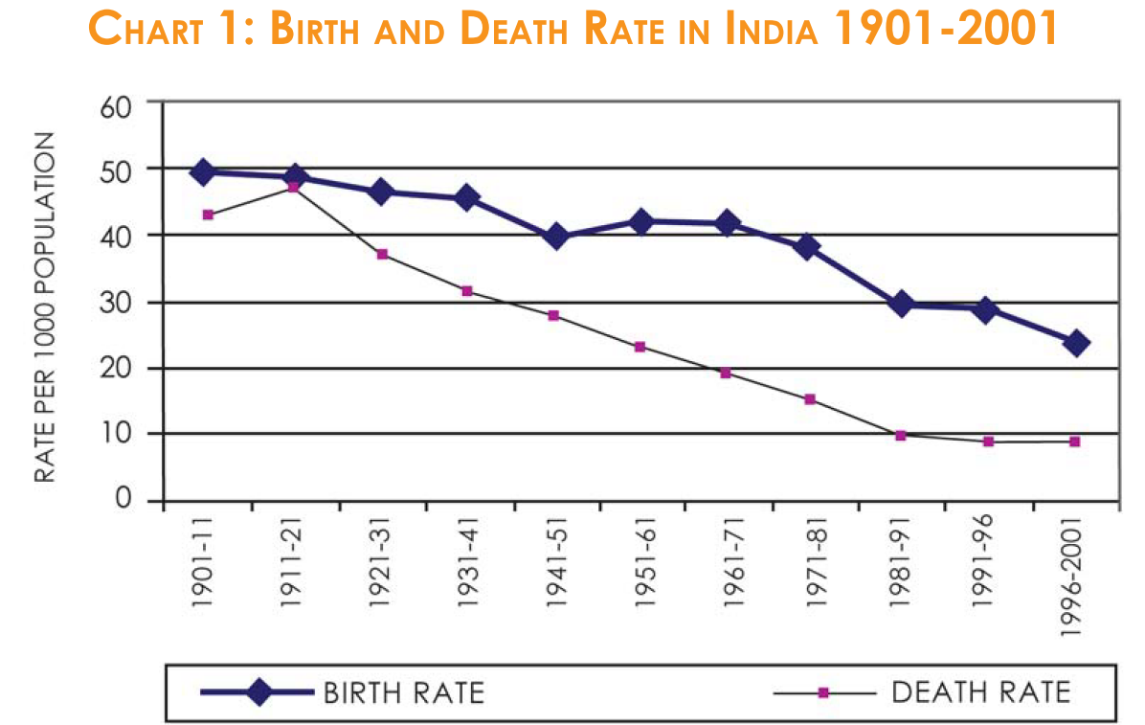
NCERT Class12 Sociology ch.2
(R) Birth is socio-culture phenomenon, hence slow to change.
(A) Birthrate not falling as fast as death rate

Slide 17
Formulas: Birth and Death
Birth Rate
Live birth / 1000
Death Rate
Death / 1000
Rate of natural increase
Stabilized
“replacement level”
Negative: Japan, E.Europe

Slide 18
Fertility
Fertility rate
Live births per 1000 women in 15-49 age
Total fertility Rate (All India: 2.4; Kerala<2)
IF woman lived through that age group, how many babies?
Target: 2.1 (Replacement level)- she +her husband replaced
Extra 0.1 to compensate risk of unforeseen accident/deaths
2.5 as pe HDR-UNDP
Notes:
Total fertility rate
# of children born to a woman
The total fertility rate refers to the total number of live births that a hypothetical woman would have if she lived through the reproductive age group and had the average number of babies in each segment of this age group.

Slide 19
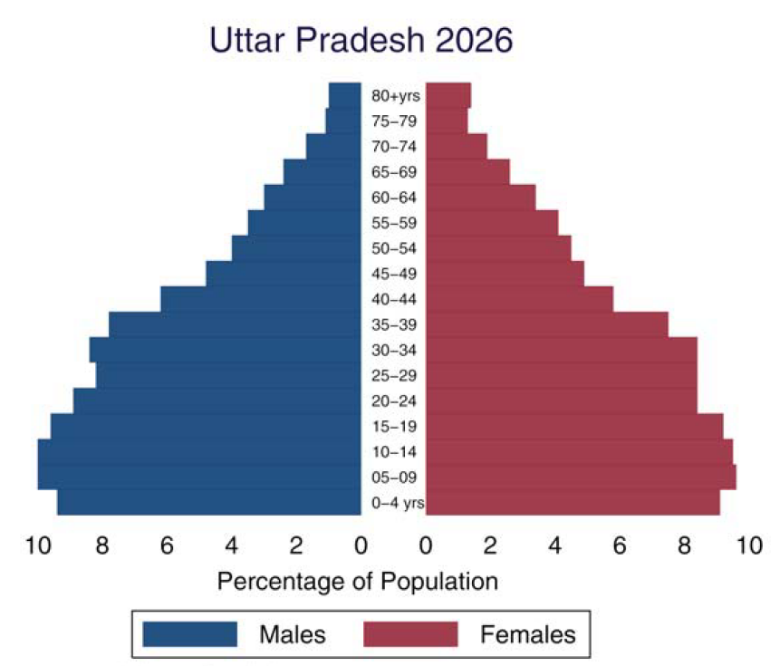
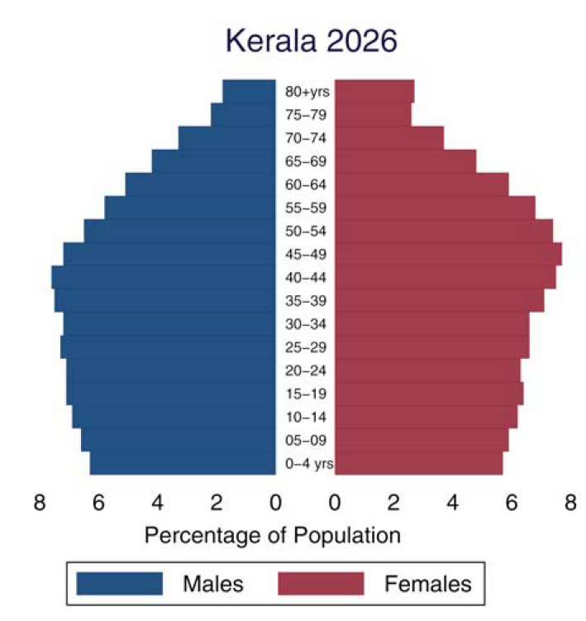
Age pyramid
T.F.R. <2 and women live longer.
CENSUS 2011: Avg. age
youngest state: Meghalaya, Oldest- Kerala

Slide 20
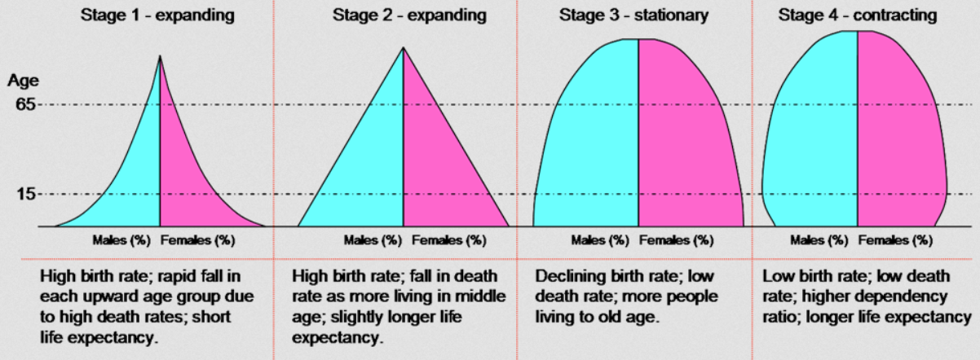
Theory of demographic transition
India is in 3rd stage since Census 2011

Slide 21
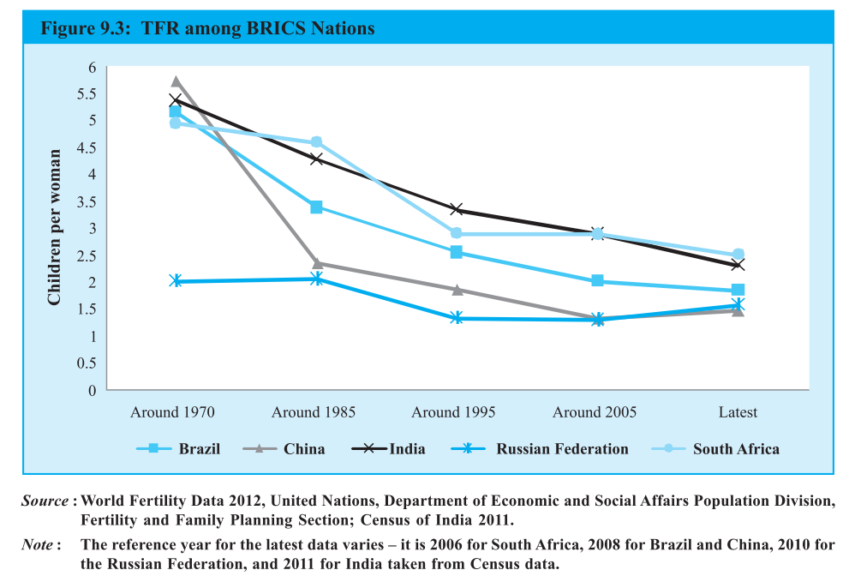
TFR comparison among BRICS
China, Russia, pop down

Slide 22
Dependency Ratio will be low during dem.div
Aka unproductive consumers
43% below 15
<15 or >64
(dependent population)
Dependency
Ratio%
(UNDP-HDR)
Pop. In 15-64 age
(working pop.)
8% above 64
Notes:
NIOS has different age, but we’ll go with NCERT here.

Slide 23
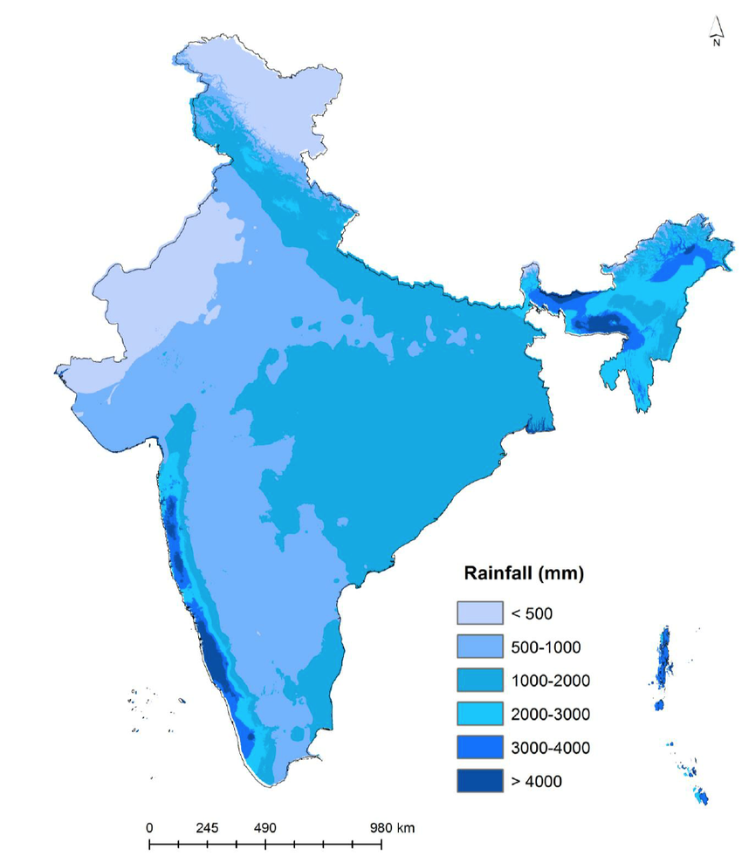
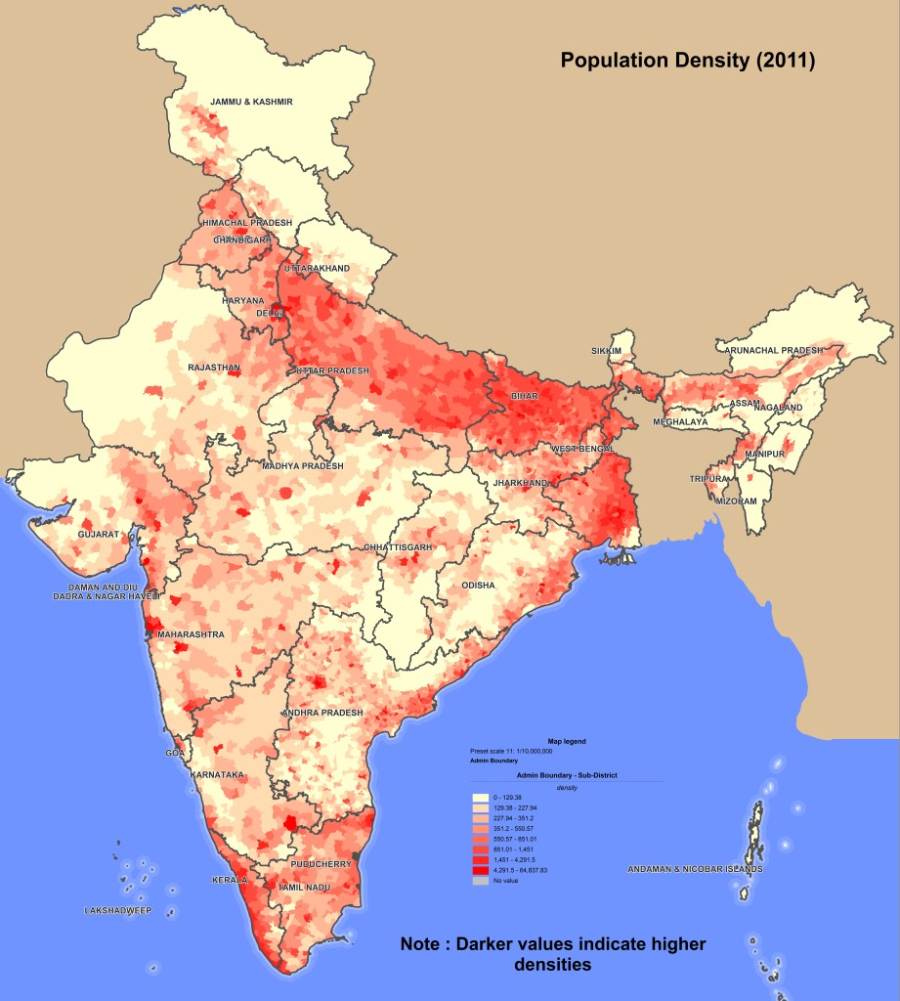
Highest
Lowest
Bihar (1106)
Delhi (11,320)
A&N(46)
Arunanchal (17)
Generally population map of India, follows its rainfall map (except North East, Southern side of Himalaya)
India is tropical, rainfall plays more imp. Role than temperature in pop-distr.
Pop.Density = total pop/total land area (sq.km) = 382 all India

Slide 24
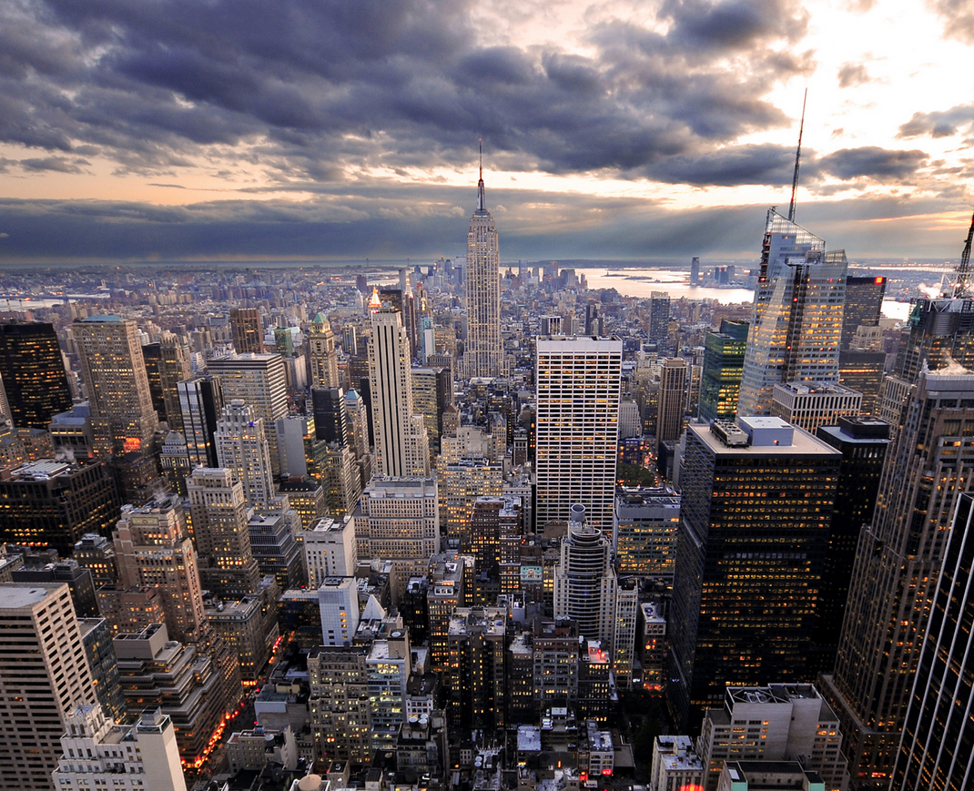
Distribution of 121 cr. Population (census-2011)
Rural = not in urban category.

Slide 25
Urban area
Statutory towns
Census towns
Outgrowths
municipality, corporation, cantonment board or notified town area committee, etc. (4000+)
Min 5k people; min.75% engaged in non-agro; Min. density: 400/sqkm (3800+ census towns)
Railway colony, uni.campus etc. wherein Electricity, post-office, bank etc. available

Slide 26
Census 2011: highest population
States
UP
W.Bengal
UT
Delhi
Maharashtra
Bihar
Andhra Pradesh
Pudu
Chandi
A&N
D&N
DECREASING
LOWEST SIKKIM
LOWEST: Lakshadweep

Slide 27
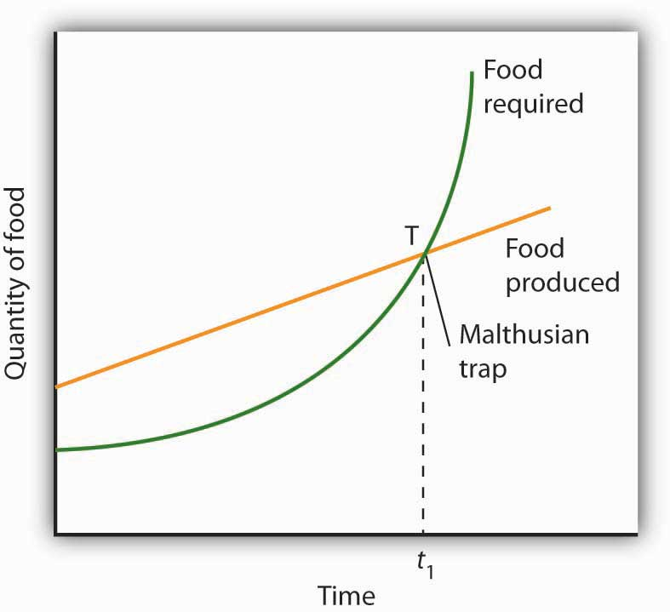
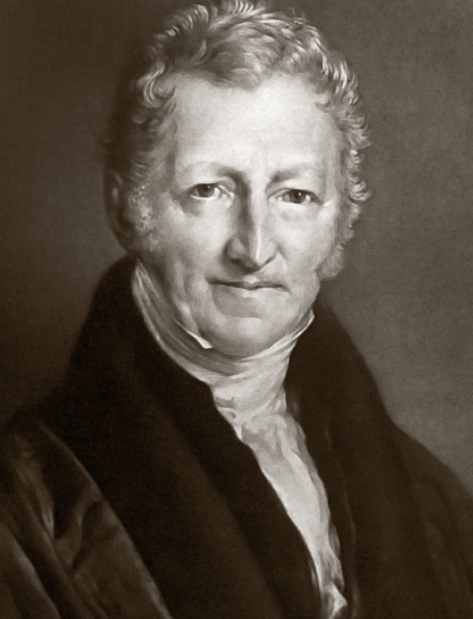
NCERT Soc. Class12
Thomas Malthus (1766)
Population
Geometric growth
Food production
Arithmetic growth
preventive checks (man himself)
Food shortage, famine,
Marriage postpone,
Positive Check (Nature/God)
Family planning
disease, epidemics
Celibacy
Marxist critized me. But Population control also necessary to pass competitive exams easily….लेकिन साला कोई बात समजने को तैयार नही.
Notes:
Food production: Arithmetic
Population: Geometric
preventive checks: Marriage postpone, family planning
Food shortage, war, famine, epidemics ► population control =Positive checks on population
But mankind has survived.

Slide 28
NIOS Economy
In 3rd world country, high population growth ___.
Negatively affects capital formation
Positively affects capital formation
Doesn’t affect capital formation
Either (A) or (B) depending on Economic policy of a country.
More resources go into consumption rather savings and capital formation.

Slide 29
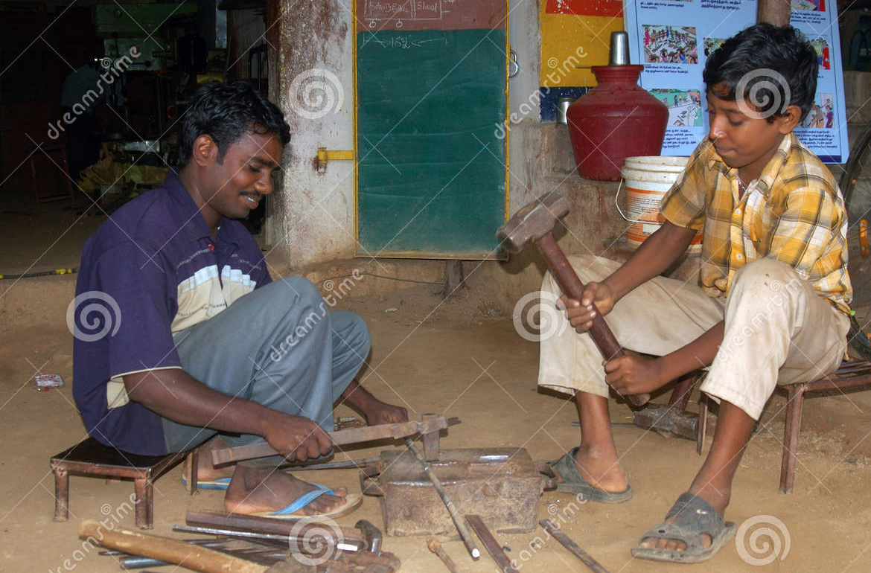
3rd world country
High population growth
Capital formation ▼
Disguised unemployment ▲
Large pop. Becomes liability than ASSET

Slide 30
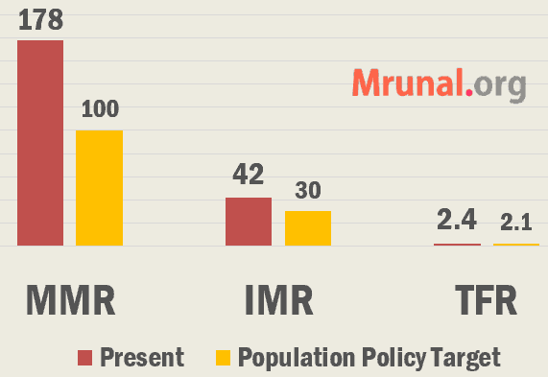

Population 2000
Policy
Girl Marriage @20| 2 child
80% institutionalized deliveries
MMR: <100 / lakh
TFR: 2.1 @2010 (2.4)
Stable population @2045 2070
Safe abortion, Sterilization, family planning
HIV control
Universal immunization
Compulsory registration of birth and death
IMR, MMR related schemes etc. in the second part of the lecture

Slide 31
Population 2000 bodies
Policy
National Commission on Population under PM, Health Min.
Jansankhya Sthirata Kosh (JSK)- society registration. Maal under Health Dept Secretary

Slide 32
BES166 ► HRD ► 1) Census
Census Theory
Pop. Growth-stages, concepts, formulas
Diversity: Language, Religion, Ethnic Composition
NCERT Sociology terms

Slide 33
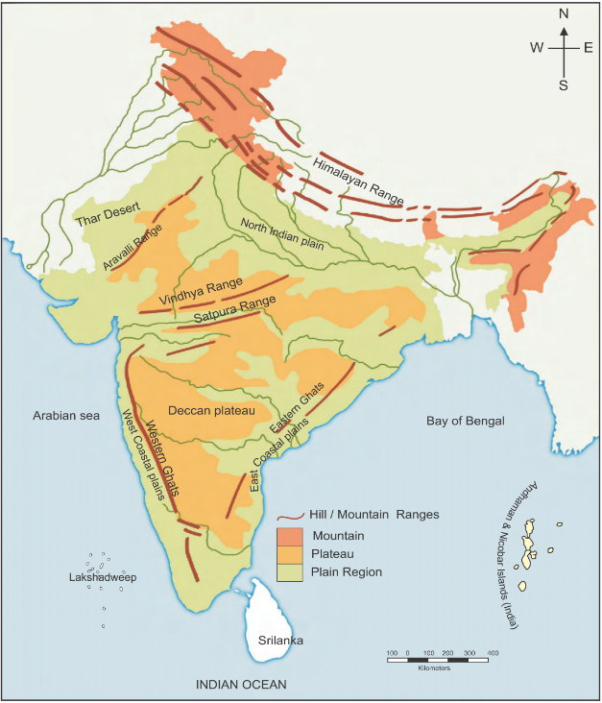

Ethnic Composition (Khullar Ch.11)
Andaman (Negrito)
Great Andamanese, Onge, Jarawa and Sentinalese
Nicobar (Mongoloid)
Nicobarese and Shompens
India Yearbook
Tribe “o” more than island’s spelling
SK Guha (Ex-Director Anthro-Survey of India)
Negrito (First to arrive)
Proto-Australoids: Bhil, Munda (2nd to arrive)
Mongoloids
Mediterranean
Western Brechyphals (+ subcategories: e.g.Parsi)
Nordic (Last- 2nd bc, vedic aryan)

Slide 34
Name of the State /UT | Name of PTGs / particularly vulnerable tribal groups
Andhra Pradesh | 1. Bodo Gadaba, (2. Bondo Poroja, (3. Chenchu, (4. Dongria Khond, (5. Gutob Gadaba, (6. Khond Poroja, (7. Kolam, (8. Kondareddis, (9. Konda Savaras, (10. Kutia Khond, (11. Parengi Poroja, (12. Thoti
Bihar (including Jharkhand) | 13. Asurs, (14. Birhor, (15. Birjia, (16. Hill Kharia, (17. Korwas, (18. Mal Paharia, (19. Parhaiyas, (20. Sauria Paharia, (21. Savar
Gujarat | 22. Kathodi, (23. Kotwalia, (24. Padhar, (25. Siddi, (26. Kolgha
Karnataka | 27. Jenu Kuruba, (28. Koraga
Kerala | 29. Cholanaikayan, ((a section of Kattunaickans), (30. Kadar, (31. Kattunayakan, (32. Kurumbas, (33. Koraga
MP+Chhattisgarh | 34. Abujh Marias, (35. Baigas, (36. Bharias, (37. Hill Korbas, (38. Kamars, (39. Saharias, (40. Birhor
Maharashtra | 41. Katkaria, ((Kathodia), (42. Kolam, (43. Maria Gond
Manipur | 44. Marram Nagas
Orissa | 45. Birhor, (46. Bondo, (47. Didayi, (48. Dongria-Khond, (49. Juangs, (50. Kharias, (51. Kutia Kondh, (52. Lanjia Sauras, (53. Lodhas, (54. Mankidias, (55. Paudi Bhuyans, (56. Soura, (57. Chuktia Bhunjia
Rajasthan | 58. Seharias
Tamil Nadu | 59. Kattu Nayakans, (60. Kotas, (61. Kurumbas, (62. Irulas, (63. Paniyans, (64. Todas
Tripura | 65. Reangs
UP+Uttarakhand | 66. Buxas, (67. Rajis
West Bengal | 68. Birhor, (69. Lodhas, (70. Totos
Andaman & Nicobar Islands | 71. Great Andamanese, (72. Jarawas, (73. Onges, (74. Sentinelese, (75. Shom Pens
Not all states/UT have PTG/pvTG
Which ones in your state? For interview
Notes:
https://www.google.co.in/imgres?imgurl=http%3A%2F%2Fwww.c4learn.com%2Fcurrent-affairs%2Fwp-content%2Fuploads%2F2015%2F07%2Findian-population.jpg&imgrefurl=http%3A%2F%2Fwww.c4learn.com%2Fcurrent-affairs%2F2015%2Findia-to-become-most-populous-nation-by-2022-un-world-population-prospects.html&docid=ucjnXwRt9--sFM&tbnid=wYg7C_xlQFRHsM%3A&w=1000&h=663&client=firefox-b&bih=489&biw=1024&ved=0ahUKEwjm7ra3yPXNAhUKMY8KHYGgAa8QMwgxKAEwAQ&iact=mrc&uact=8

Slide 35
Constitution: SC/ST are area wise only
No SC (Art.341)
Nagaland
No ST (Art.342)
A&N
Lakshadweep
Haryana
Punjab
Chandigarh
Delhi
Pondicherry
Arunanchal
Governor ► President “MAY” Specify
Parliament “may” amend list
Notes:
Gond are ST in Madhya Pradesh, SC in UP

Slide 36
Yearbook Ch. welfare
Criteria for inclusion in Scheduled tribe
indications of primitive traits;
distinctive culture;
shyness of contact with the community at large;
geographical isolation i.e. backwardness.
Can profess any religion
All of above
SC: Hindu, Buddh, Sikh
-D.R.Khullar
Notes:
term Scheduled Tribes is defined in the Constitution of India under Article 366(25) as such tribes or tribal communities or parts of groups within such tribes or tribal communities as are deemed under Article 342 to be Scheduled Tribes for the purposes of this Constitution. Article 342 prescribes the procedure to be followed in the matter of specification of Scheduled Tribes. In terms of Article 342(1), the President may, with respect to any State or Union Territory, and where it is a State, after consultation with the Governor thereof, notify tribes or tribal communities or parts thereof as Scheduled Tribes.
Any further amendment in the list is to be done through an Act of Parliament (Article 342(2)). Parliament may, by law, include in or exclude from the list of Scheduled Tribes, any tribe or tribal community or parts thereof.
criteria generally adopted for specification of a community as a Scheduled Tribe are :
These are not spelt out in the Constitution but have become well established.
Ascertaining ST Status of Individuals
he may profess any religion; (e) that he or his parents/grandparents, etc., should be permanent resident of the State/UT

Slide 37
Yearbook Ch. welfare
ST reservation principle(s):
No “entry” through marriage
No “exit” through marriage.
Both A and B correct
Neither A nor B”.
Notes:
term Scheduled Tribes is defined in the Constitution of India under Article 366(25) as such tribes or tribal communities or parts of groups within such tribes or tribal communities as are deemed under Article 342 to be Scheduled Tribes for the purposes of this Constitution. Article 342 prescribes the procedure to be followed in the matter of specification of Scheduled Tribes. In terms of Article 342(1), the President may, with respect to any State or Union Territory, and where it is a State, after consultation with the Governor thereof, notify tribes or tribal communities or parts thereof as Scheduled Tribes.
Any further amendment in the list is to be done through an Act of Parliament (Article 342(2)). Parliament may, by law, include in or exclude from the list of Scheduled Tribes, any tribe or tribal community or parts thereof.
criteria generally adopted for specification of a community as a Scheduled Tribe are :
These are not spelt out in the Constitution but have become well established.
Ascertaining ST Status of Individuals
he may profess any religion; (e) that he or his parents/grandparents, etc., should be permanent resident of the State/UT
Similarly, a person who is a member of a Scheduled Tribe will continue to be a member of that Scheduled Tribe, even after his or her marriage with a person who does not belong to a Scheduled Tribe.
guiding principle is that no person who is not a Scheduled Tribe by birth will be deemed to be a member of Scheduled Tribe merely because he or she has married a person belonging to a Scheduled Tribe.

Slide 38
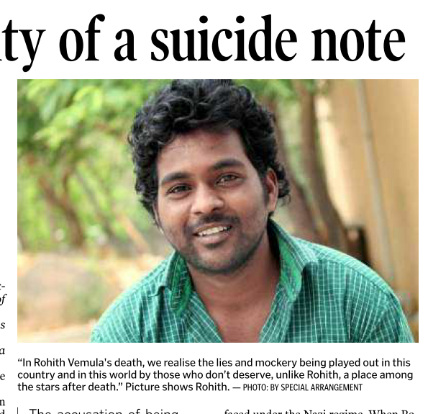
What if intercaste marriage?
Reservation
Student suicide: Father OBC, mother SC.
Intercaste marriage: child to take father’s dominant caste.
but no strict application said Supreme Court (2012)- if suffered handicaps of mother.

Slide 39
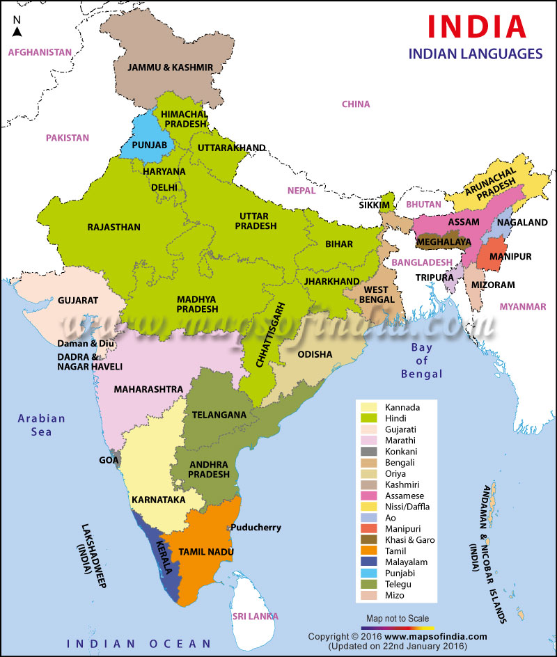
4 Language groups
Austric – Nishada: Munda; central tribal belt, islands
Sino Tibetian (Kirata): Assamese, Ladakhi
Indo Aryan: Hindi
Dravid: Telugu
Art 350-B Commissioner for Linguistic Minorities (CLM)

Slide 40
Since Census-2001, Religion also counted:
Jain MH Delhi Guj
Buddhism Sikkim Arun Miz.
Sikh Punjab Chadi Har
Christian positive sex ratio Nagaland Mizo Megh
Muslim Lxdw J&K Assam
Hindu Himachal Odisha Chhattisgarh
Internal descending order may be outdated

Slide 41
IYB: Minorities
National?
National Commission for Minorities (NCM) Act, 1992.
States
Muslims, Christians, Sikhs, Buddhists and Zoroastrians (Parsis)
Manipur and Uttarakhand have set up non-statutory
Jews in Maharashtra
States can setup their own commissions
Jains in 2014 (but court case?)

Slide 42
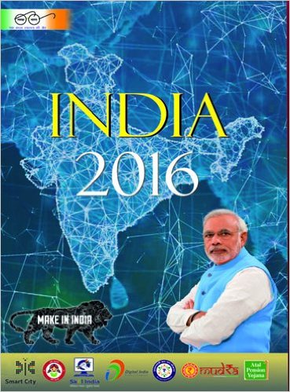
IYB ch.20 law & justice: Personal laws ► Marriage
Concurrent List
Hindu Marriage Act, 1955
Other marriages
Personal laws: matters relating to family affairs, i.e., marriage, divorce, succession, adoption, wills, etc
Not in Jammu and Kashmir (But Hindu domicile yes)
applies to Buddhists, Sikhs, Jains
applies to who are not Muslims, Christians, Parsis or Jews
Special marriage act: spouses of different religious faiths
Anand Marriage: Sikh marriage rights
Indian Jews: no law. Because marriage not civil “contract”.
Notes:
Hindu Marriage Act, 1955. This Act, which extends to the whole of India, except the state of Jammu and Kashmir, applies also to Hindus domiciled in territories to which the Act extends and those who are out side the said territories. It applies to Hindus (in any of its forms or development) and also to Buddhists, Sikhs, Jains and also those who are not Muslims, Christians, Parsis or Jews by religion. However, the Act does not apply to members of any scheduled tribes unless the Central Government by notification in the official Gazette otherwise directs. Provisions as regard to divorce are contained in Section 13 of The Hindu Marriage Act and Section 27 of The Special Marriage Act. Common ground on which divorce can be sought by a husband or a wife under these Acts fall under these broad heads adultery, desertion, cruelty, unsoundness of mind, venereal disease, leprosy, mutual consent and being not heard of as alive for seven years.

Slide 43
IYB ch.20 law & justice: Personal laws ► Adoption
Laws
Hindu Adoption & Maintenance act:’56 right to inheritance
Others: Guardian and wards act 1890- child has no legal inheritance.
Diverse, Maintenance
Hizanat: mother’s right to custody over minor children
iddat, mehr: Muslim compensation related terms.
majority of Indian-Muslims follow Hanafi doctrines of Sunni law.
Adoption rules
CARA Central Adoption Resource Authority (CARA)- Min.W+C Autonomous
Online portal- CARINGS (Child Adoption Resource Information & Guidance System)
Notes:
Hindu Marriage Act, 1955. This Act, which extends to the whole of India, except the state of Jammu and Kashmir, applies also to Hindus domiciled in territories to which the Act extends and those who are out side the said territories. It applies to Hindus (in any of its forms or development) and also to Buddhists, Sikhs, Jains and also those who are not Muslims, Christians, Parsis or Jews by religion. However, the Act does not apply to members of any scheduled tribes unless the Central Government by notification in the official Gazette otherwise directs. Provisions as regard to divorce are contained in Section 13 of The Hindu Marriage Act and Section 27 of The Special Marriage Act. Common ground on which divorce can be sought by a husband or a wife under these Acts fall under these broad heads adultery, desertion, cruelty, unsoundness of mind, venereal disease, leprosy, mutual consent and being not heard of as alive for seven years.

Slide 44
BES166 ► HRD ► Census, Population, Society
Census Theory
Pop. Growth-stages, concepts, formulas
Diversity: Language, Religion, Ethnic Composition
NCERT Sociology terms

Slide 45
NCERT sociology Class.11-12
Jajmani system
non-market barter system in goods/services
based on caste system / customs
Sociologist M.N. Srinivas
Sanskritization: middle/lower castes copy practices of brahmins or kshatriyas.
Syncretism
Intermixing hybrid of two distinct religious or cultural traditions.
Dominant caste: land owners, large number, political domination
Marriage
Endogamy: marriage permissible in this range e.g. within caste
Exogamy: marriage prohibited in this range e.g. within family, gotra, village.
TERMS

Slide 46
NCERT sociology Class.11 urban society
TERMS
Gentrification
Ghetto
Gated communities
Low class urban neighborhood ► middle/upper class
mixed group ► single group community (Jew)
upper class urban area, sealed off for outsiders.

Slide 47
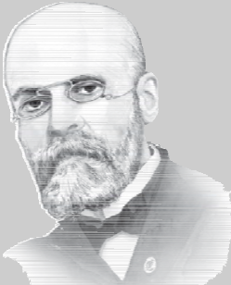
NCERT sociology Class.11
TERMS
Anomie
Social Norms breakdown (Mad Max)
Mechanical solidarity
Low division of labour
common experience and Shared beliefs (Lagaan- hate/suspect white lady)
Organic solidarity
High division of labour
Interdependence, economic reciprocity. (Rang De- help white lady director)
Emile Durkheim, France, Jew

Slide 48
BES166 ► HRD: Today’s Topics
Census
Edu. Policy 2016
Health-Women, Children
HDI-2015 | SDG

